Slide 1
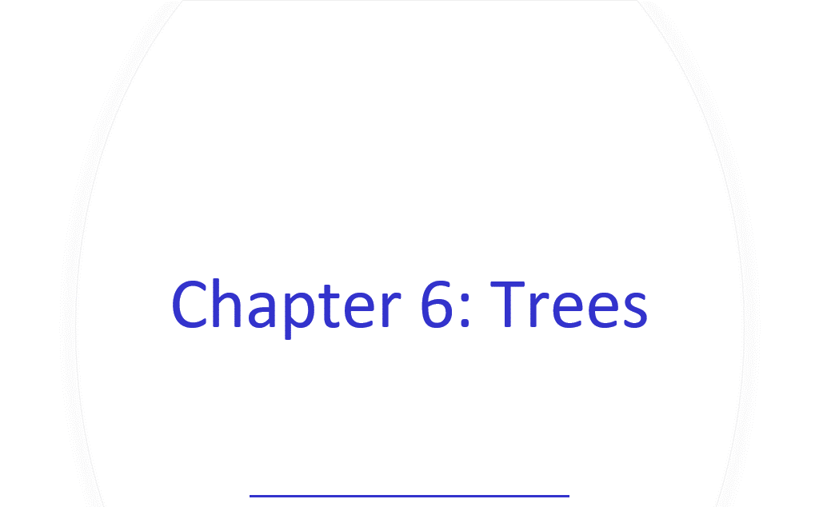
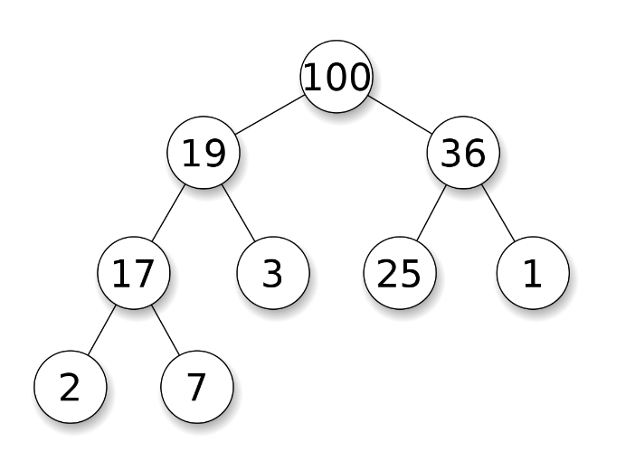
Binary Trees, Binary Search Trees, Balanced trees, general trees, multi-way trees, tries, heaps​

Slide 2
Learning Outcomes
Heap Data Structure
Representation & Implementation
Algorithms
Applications
Priority Queue (used in Dijkstra’s SP algorithm)
HeapSort

Slide 3
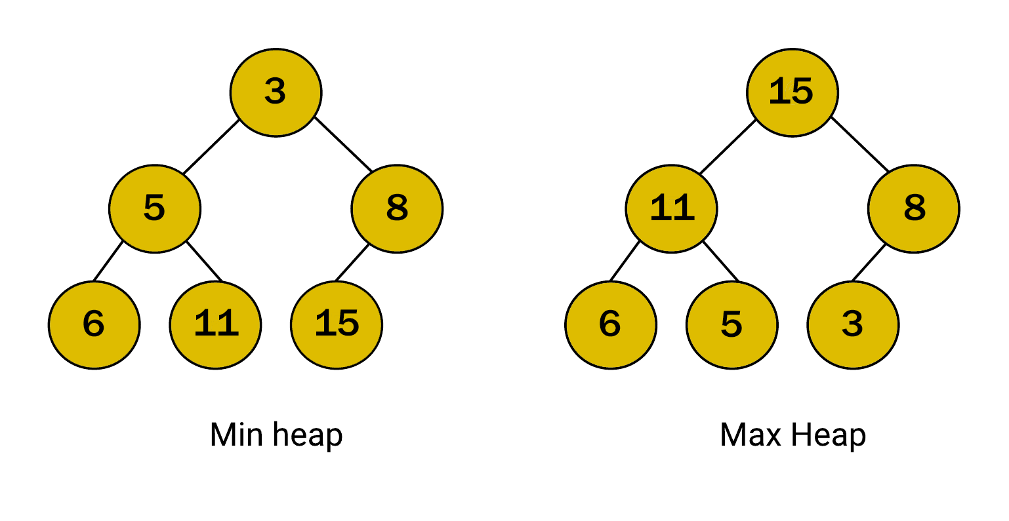
Heaps
A heap is a binary tree that has the following properties :
it is complete i.e. each level is completely filled except perhaps the bottom level and in this level the nodes are in the left-most positions.
the data items stored in each node is >= the data items stored in each of it's children (Max heap)
https://medium.com/javascript-in-plain-english/heaps-of-data-structures-creating-heaps-in-code-80d215dcf53d
Visualization: https://www.cs.usfca.edu/~galles/visualization/Heap.html

Slide 4
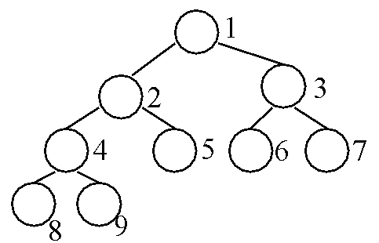

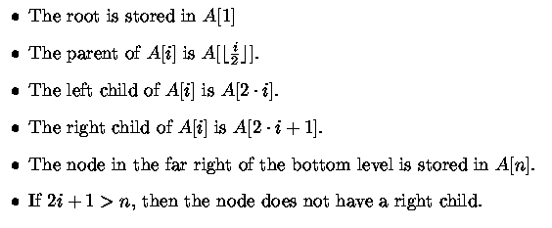
Heap Data Structure
Completely Balanced Binary Tree Implemented by an Array

Slide 5
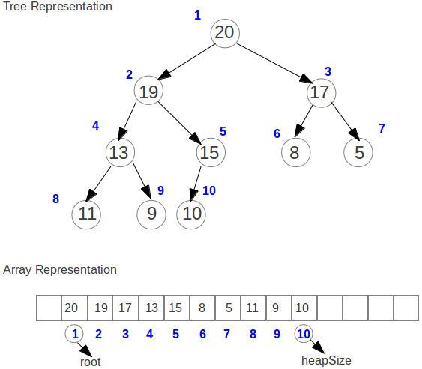
Heap

Slide 6
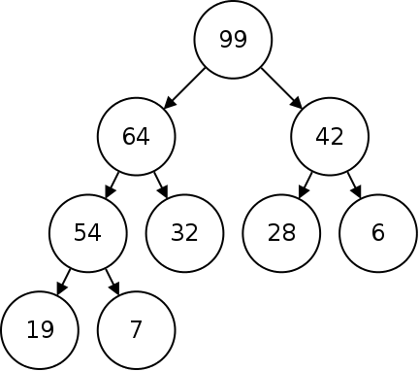
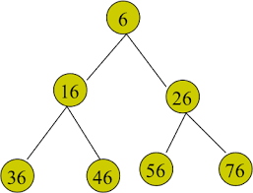
Heaps
Notes:
Max-heap, the largest key at the root or Min-heap, the smallest key at the root.
Can simply store a heap in an array
The children of i^{th} node are calculated at
locations [2*i] and [2*i+1]
(assume root at index 1)
Similarly, the parent of the i^{th} node is at location [i DIV 2].
The completeness property guarantees that the data items will be stored in consecutive locations at the beginning of the array.

Slide 7
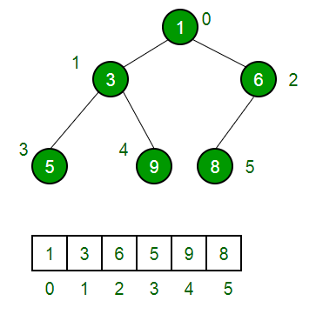
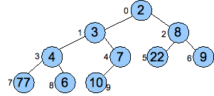
Heaps
Q?: Calculate if root in position 0.
Parent, children, is leaf, last node, last parent

Slide 8
Quiz ???
Insert the following list of numbers 1,3,5,7,9,2,4,6,8,10
i) unto a heap (largest at top)
ii) unto a B-tree of order 3
Assume A is a heap with 70 members.
i) Is A[45] a leaf node ?
ii) What is the index of the first leaf node ?
iii) Who is the parent of A[50]?
iv) Who are the children of A[10] ?
v) Does any item have exactly one child ?
vi) What is the depth of the tree ?
vii) How many leaf nodes does the tree have ?

Slide 9
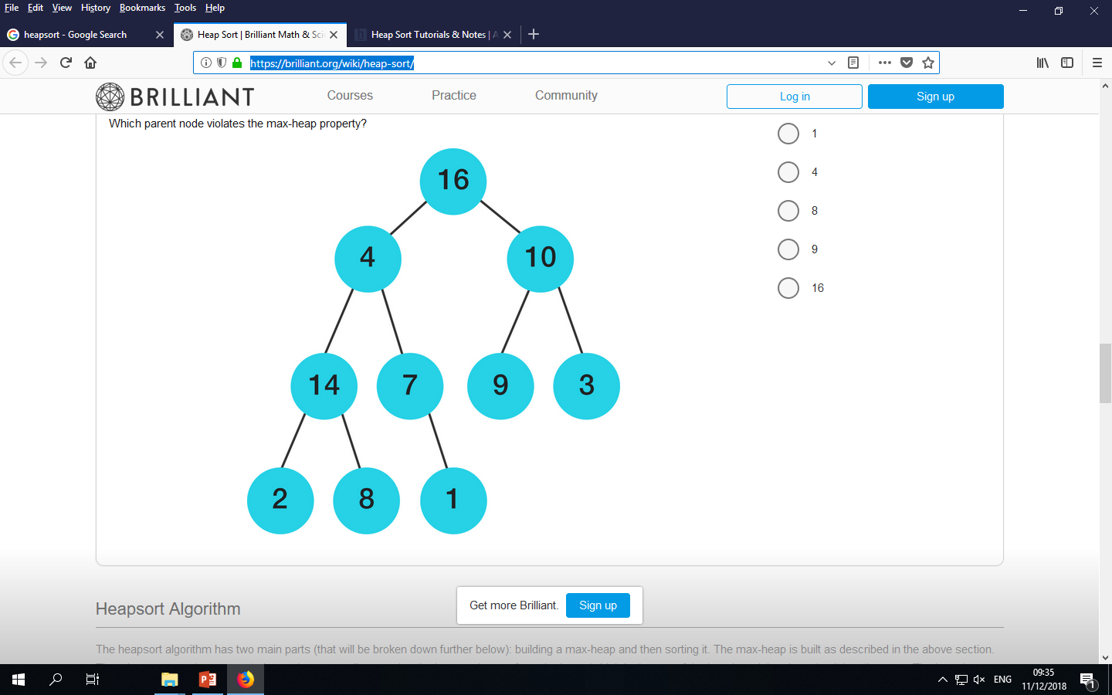

Slide 10
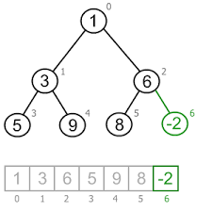
Heap Algorithms
Most algorithms on heaps operate along some path from the root to the bottom of the heap either upwards or downwards. (i.e. moving from parent to child or child to parent).
Insert algorithm
Remove (root) algorithm
Convert a binary tree to a heap (Heapify)

Slide 11
Insert unto a Heap
will increase size of heap by 1 (N incremented).
new data item put in element position a[N]: completeness property, but this may violate the heap property: (the new node > parent)
If heap property is violated then violation can be fixed by exchanging the new node with it's parent.
This may in turn cause a violation at next level up and thus can be fixed in the same way until …

Slide 12
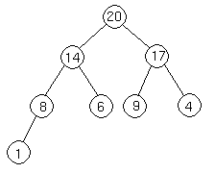
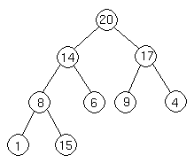
Insert operation
Put in last position, but …
violates heap property
Insert 15

Slide 13
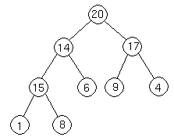
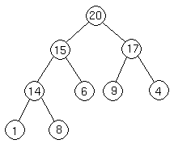
Insert operation
Restore by exchanging 15 with it’s parent but still heap property violated.
15 swapped with it’s parent again and now completed

Slide 14
Algorithms :
Insert adds a new item to a[N], and then calls Upheap(N) to fix the heap violation at N.
InsertHeap (int v)
{
N= N+1
a[N] = v
upheap(a,N)
}

Slide 15
Upheap Function
UpHeap (Array A, int current) /*current is starting position
{
while current >1 do /*value at parent < value child
{
parent = current DIV 2;
if A[parent] < A[current] then
swap(A[current],A[parent]) /* swap parent & child
current = parent;
else
current=1; /* flag to end loop
endif
}
}
Assume:
First index in array A is 1
Swap function already exists

Slide 16
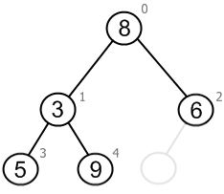
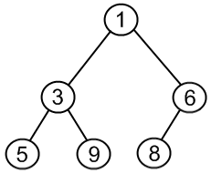
Remove (root) operation
Removing the element at root (i.e. largest element or smallest element).
Since the heap will be one element smaller after the operation, it is necessary to decrement N.
The largest element in a[1] is to be removed, so the Remove operation amounts to overwriting a[1] with a[N].
http://www.algolist.net/Data_structures/Binary_heap/Remove_minimum

Slide 17
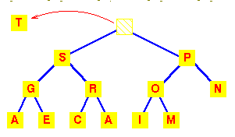
Remove Root:
Removing T involves overwriting it with M and maintaining the heap property down the heap (as before).

Slide 18
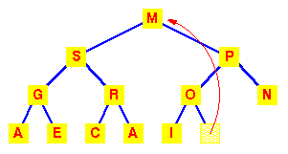
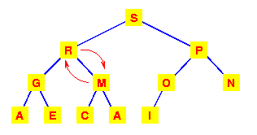
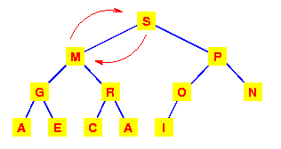
Heap property violation
Move last element (M) up
Results in:

Slide 19
Remove Algorithm
int Remove ()
{
int top;
top = a[1];
a[1] = a[n];
n = n-1;
downheap(a,1);
return top;
}

Slide 20
DownHeap procedure
Downheap(a,1):
This procedure moves down the heap
starting at position k=1 (root),
exchanging the node at position k with the larger of it's 2 children, if necessary and
stopping when the node at k is larger than both children or the bottom is reached.
Note: may downheap from any index.

Slide 21
DownHeap Function
DOWNHEAP(array A, int current)
{
while current <= N DIV 2 do /* <= last parent
{
i = 2 * current /* 1st child of current*/
if i < N AND A[i] < A[i+1] then /* finding the largest of*/
i = i+1 /*both children */
endif
if A[current ]< A[i] then /* parent smaller than largest child
swap (A[current] ,A[i]);
current = i;
endif
}
}

Slide 22
Another version - recursive
DownHeap (A, i)
{ l = left(i)
r = right(i) if l <= heapsize[A] and A[l] > A[i]
largest = l ; else largest = i ; if r <= heapsize[A] and A[r] > A[largest]
largest = r; if largest != i
{
swap (A[i] , A[largest] ) DownHeap(A, largest)
}
}
Calling statement: Downheap (Array,1)

Slide 23
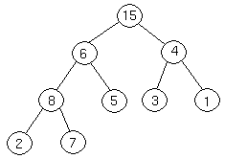
Convert a binary tree to a heap (Heapify)
To convert a complete binary tree to a heap,
first go to the index of the last parent node. This is given by (HeapSize Div 2). (Index 4 (8) below)
We then apply the Down Heap routine to each node from this index down to index 1. (Note that this is each node from index 4 down to index 1, not just the nodes along the path from index of 4 to index 1.)
Write the full algorithm!
First Part: https://www.cs.usfca.edu/~galles/visualization/HeapSort.html

Slide 24
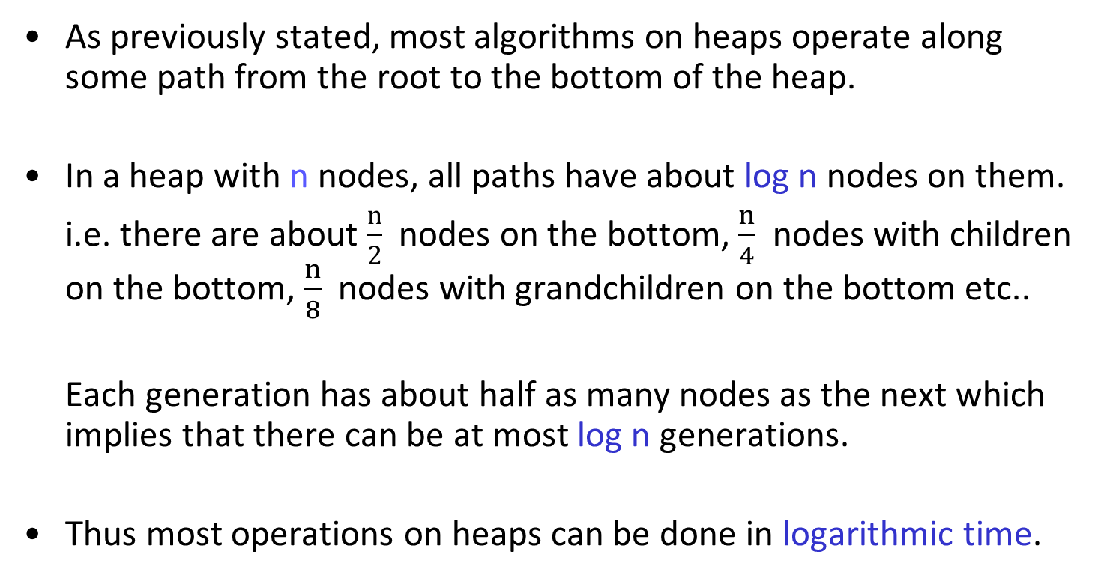
Heaps

Slide 25
Review
What is a heap ? Give an implementation of a heap.
Outline the algorithm to delete an item from position 1 in a heap.
Discuss what would be required to delete an item from position n in a heap.
Outline the algorithm to merge two heaps together to produce one heap.

Slide 26
Application of Heaps: Priority Queues
A priority queue is a data structure related to a queue.
Each data item has a certain priority associated with it and these items are stored in such a way that those with higher priority are removed from the queue and serviced before those of lower priority i.e. time of arrival is not a factor.
A priority queue has only 2 operations:
- insert an item
- remove an item with highest (or smallest) key.
Note: no find operation and time is not a factor

Slide 27
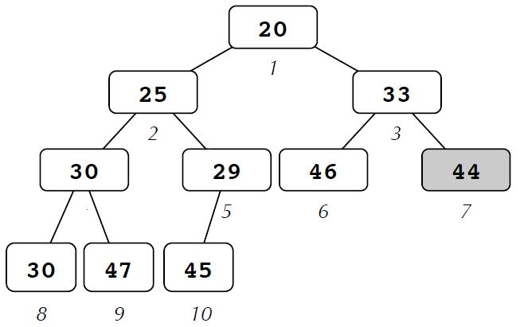
Priority Queues
Applications include simulation systems (where the priorities might correspond to event times which must be processed in order), job scheduling (highest priority indicates the next user to be processed), and numerical computations (where the priority might be computational errors, so the largest can be worked on first).
Used in Dijkstra’s Shortest Path Algorithm

Slide 28
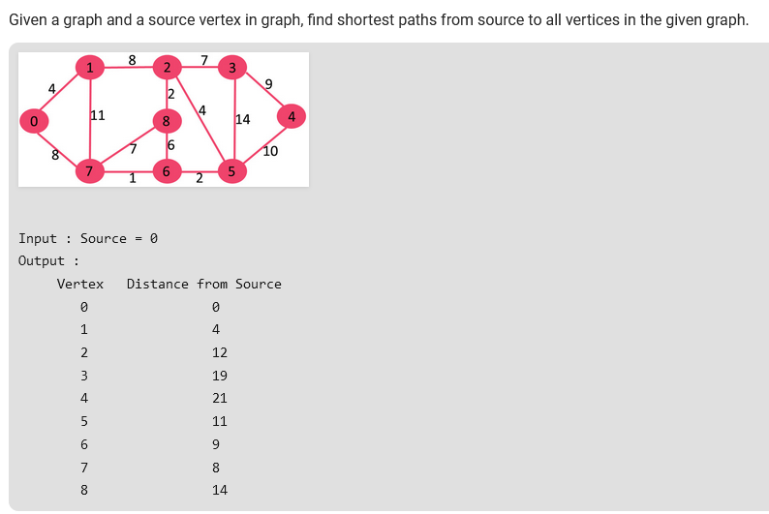
https://www.geeksforgeeks.org/dijkstras-shortest-path-algorithm-using-priority_queue-stl/

Slide 29
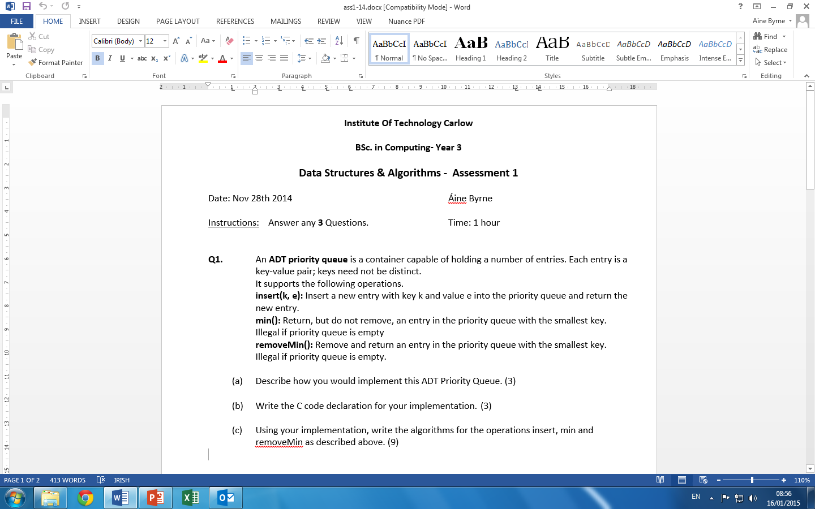

Slide 30
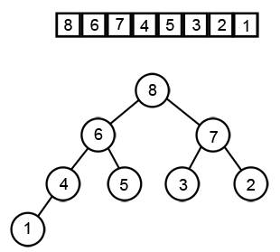
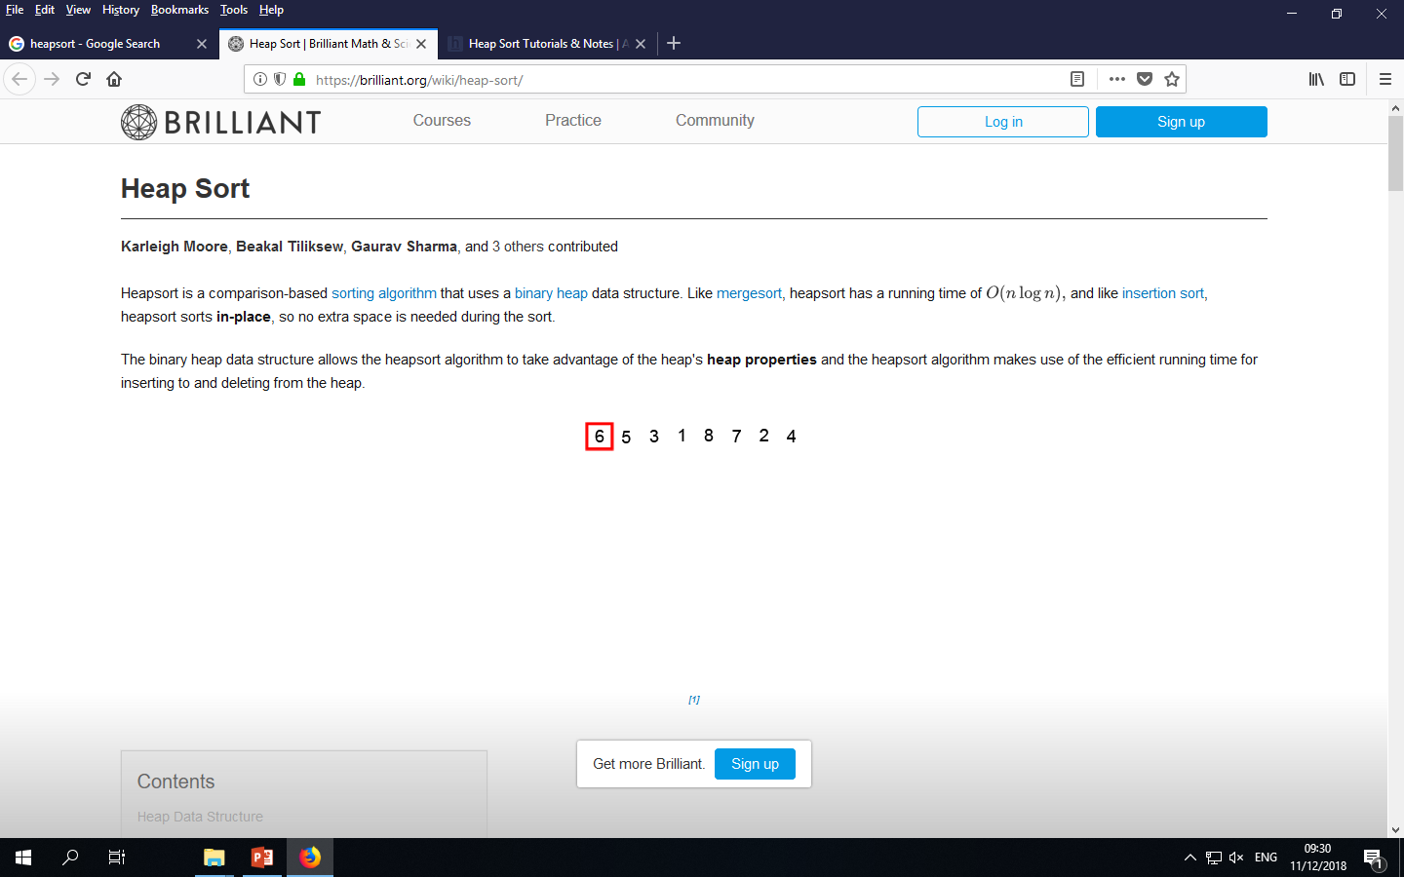
Application of Heaps: HeapSort (Max heap)
Heaps can be used in sorting an array.
In max-heap, maximum element will always be at the root.
HeapSort uses this property of heap to sort the array.
The Heap sort algorithm starts by building a heap
from a complete binary tree or
from an empty heap and add elements one by one to the input array A[1 . . n]
https://brilliant.org/wiki/heap-sort/

Slide 31
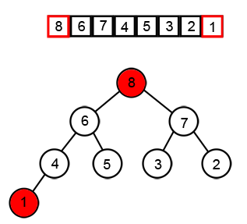
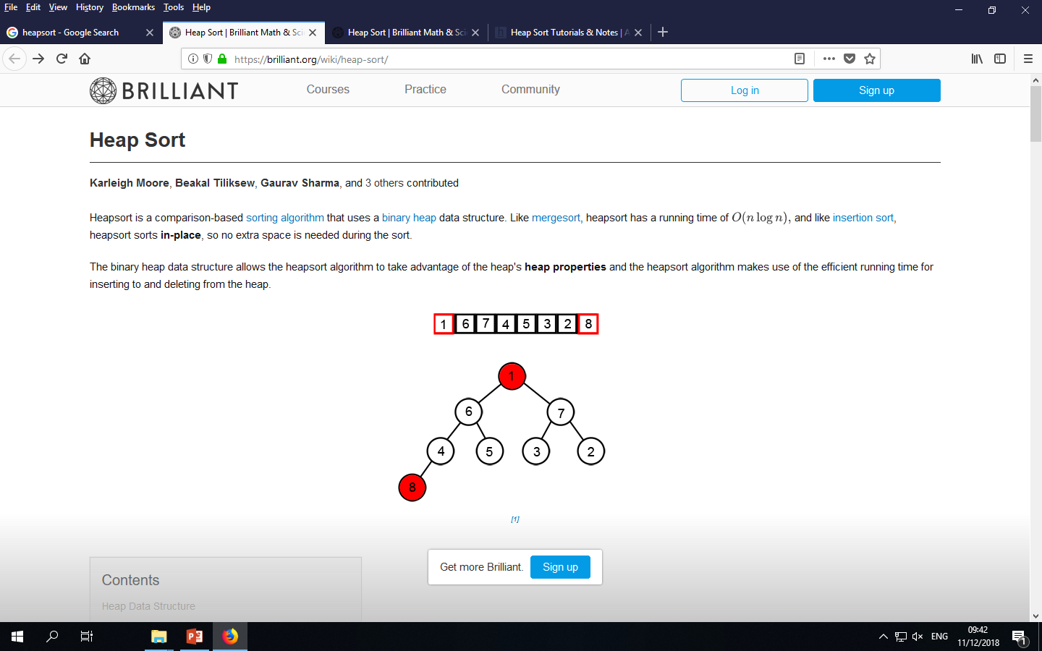
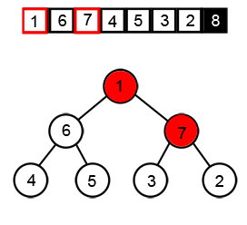
Heap Sort Algorithm (Max heap)
Since the maximum element of the array stored at the root A[1], it can be put into its correct final position by exchanging it with A[n] (the last element in A).
If we now ignore node n from the heap then the remaining elements can be the heap.
Note that the new element at the root may violate the heap property therefore might need to restore the heap property.

Slide 32
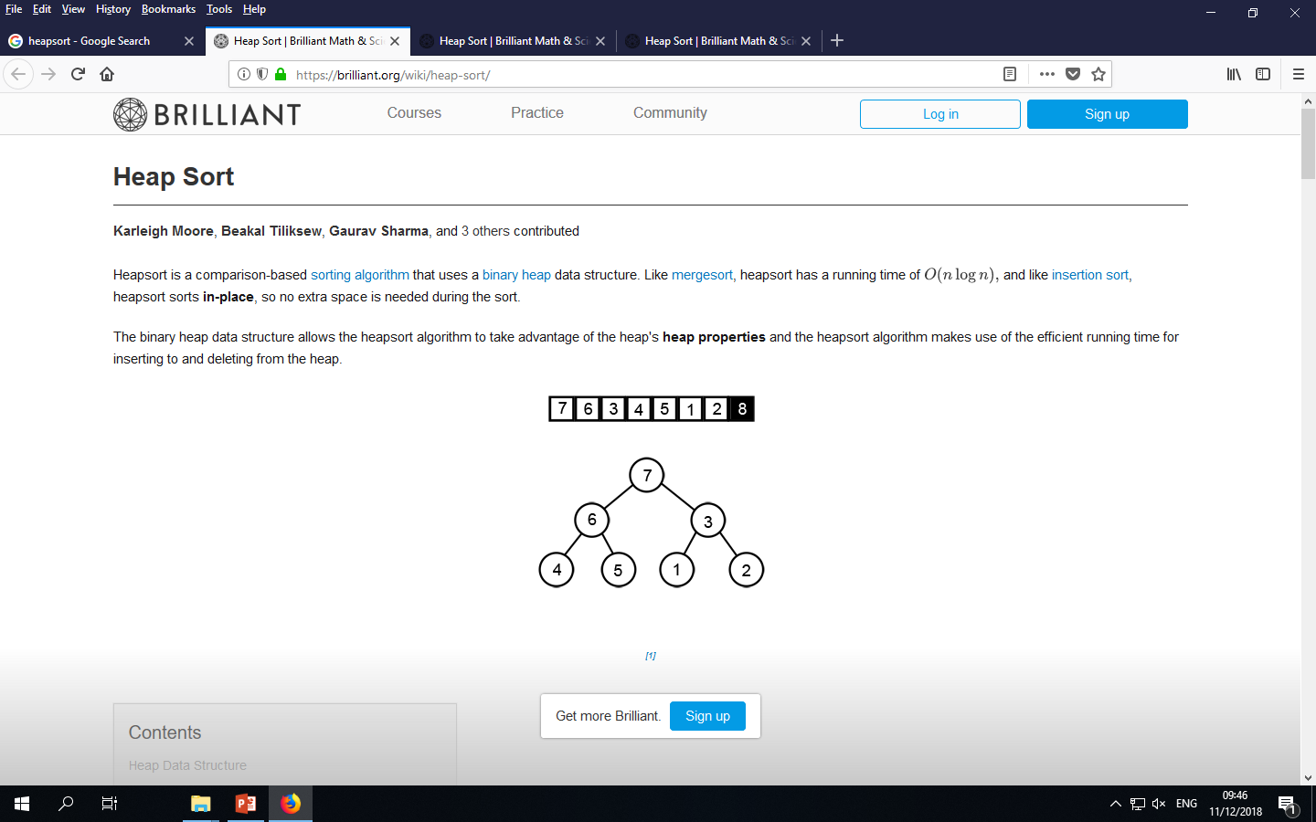
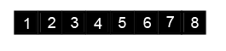
…..
https://brilliant.org/wiki/heap-sort/

Slide 33
Heap Sort Algorithm (max heap)
Algorithm:
build heap (heapify)
swap the first element with last element
reduce size of heap by one
remake the heap
Repeat while there are at least two elements on heap.
HEAPSORT (A)
A= Heapify (A)
for i = size (A) down to 2 do exchange A[1] with A[i] N-- Downheap (A, 1)
https://www.cs.usfca.edu/~galles/visualization/HeapSort.html

Slide 34
